Slide 1
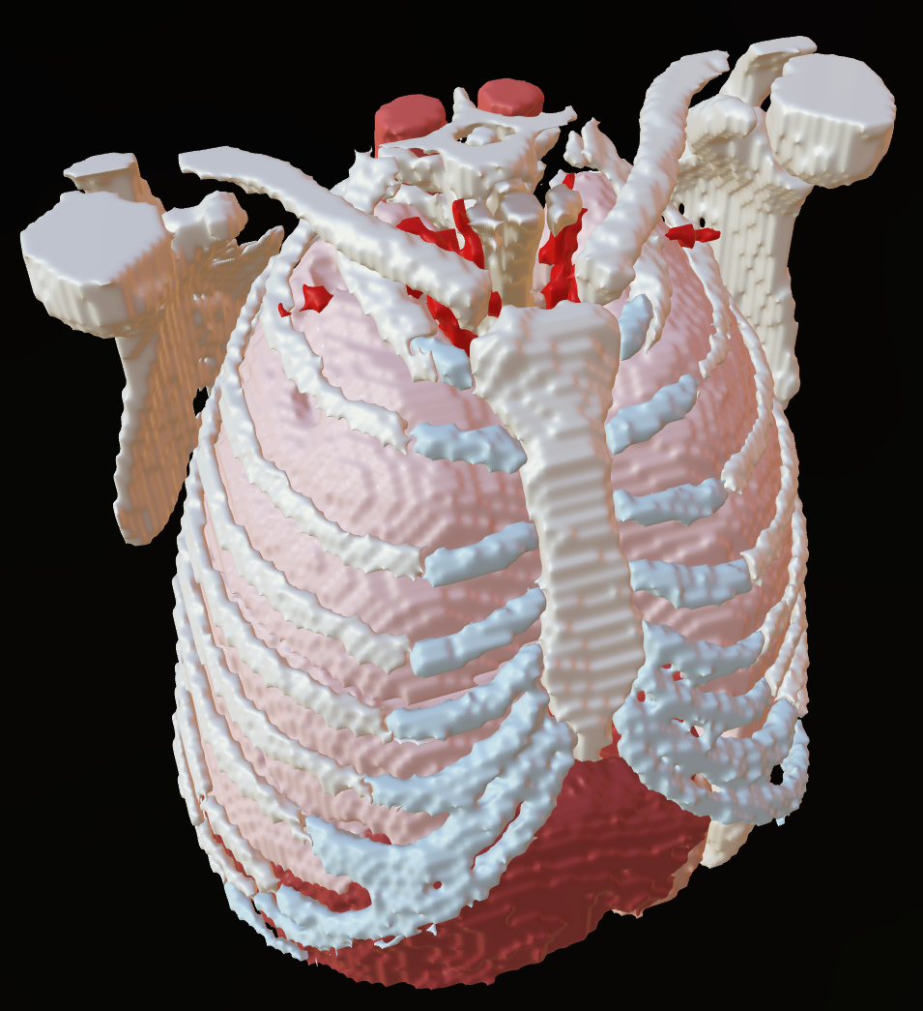
Automating Medical Illustration Tasks with Python
Kristen Browne MSc/MScBMC
Contractor - Guidehouse Inc
National Institute for Allergy and Infectious Diseases (NIAID)
Bioinformatics and Computational Biosciences Branch (BCBB)
Notes:
Hi, I’m Kristen Browne, I’m a contractor for Guidehouse working with the National Institute of Allergy and Infectious Diseases in our Bioinformatics and Computational Biosciences Branch. Today I’ll be encouraging to you think about how you can use programming, specifically Python programming, to automate certain aspects of your work. I’ll be giving some background, then working through some examples. I’m generally focusing on 3D because that’s my area of expertise, but if you have questions about how this might be used in the 2D space, please come talk to me. In my examples I’ll be working towards processing a directory of DICOMs into files like this where all of the organs have materials and are in a single file per dicom. You could process on or a thousand dicoms this way with a single python script.

Slide 2
Had to perform the same sequence of steps on the same type of asset in many projects?
Had to change the suffixes on a lot of files?
Output files in multiple formats?
Update or add metadata to file headers?
Handle any task that requires the same sequence of steps between one or more pieces of software?
Have you ever…
Then you should Learn Python!
Notes:
Have you ever had to any of these tasks? Renaming a lot of files, maybe adding a suffix or a prefix? Had to do the same kind of model handling over and over, like adding the same materials to anatomical models? Maybe you’re doing a lot of file conversions so you have models in different formats, handling metadata, cleaning up meshes, setting up scenes… basically anything that requires you to do the same button clicks or steps over and over again? Then you should think about Learning Python! I’ve noticed many are hesitant when I bring up coding or programming because they don’t know how to approach learning of find even the idea of coding to be overwhelming. So to start, I thought I’d share how I got started with programming in general, and how that led to learning my new favorite language, Python.

Slide 3

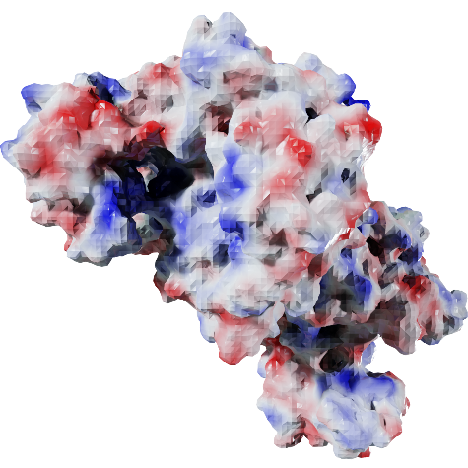
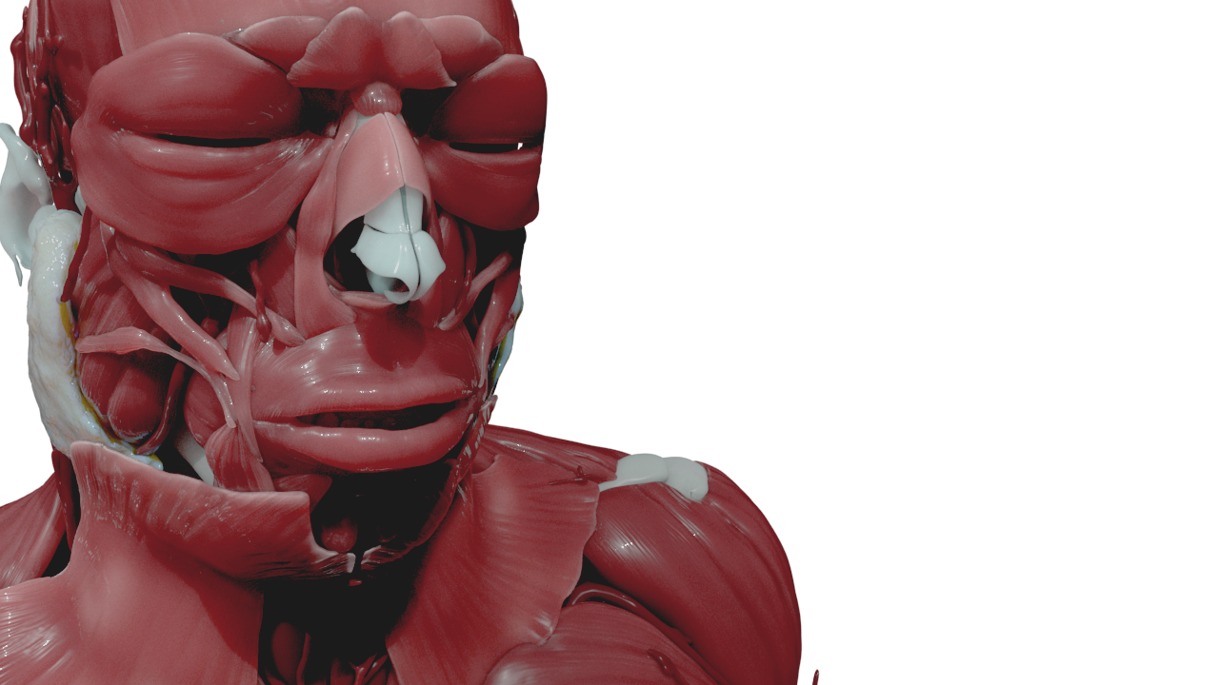
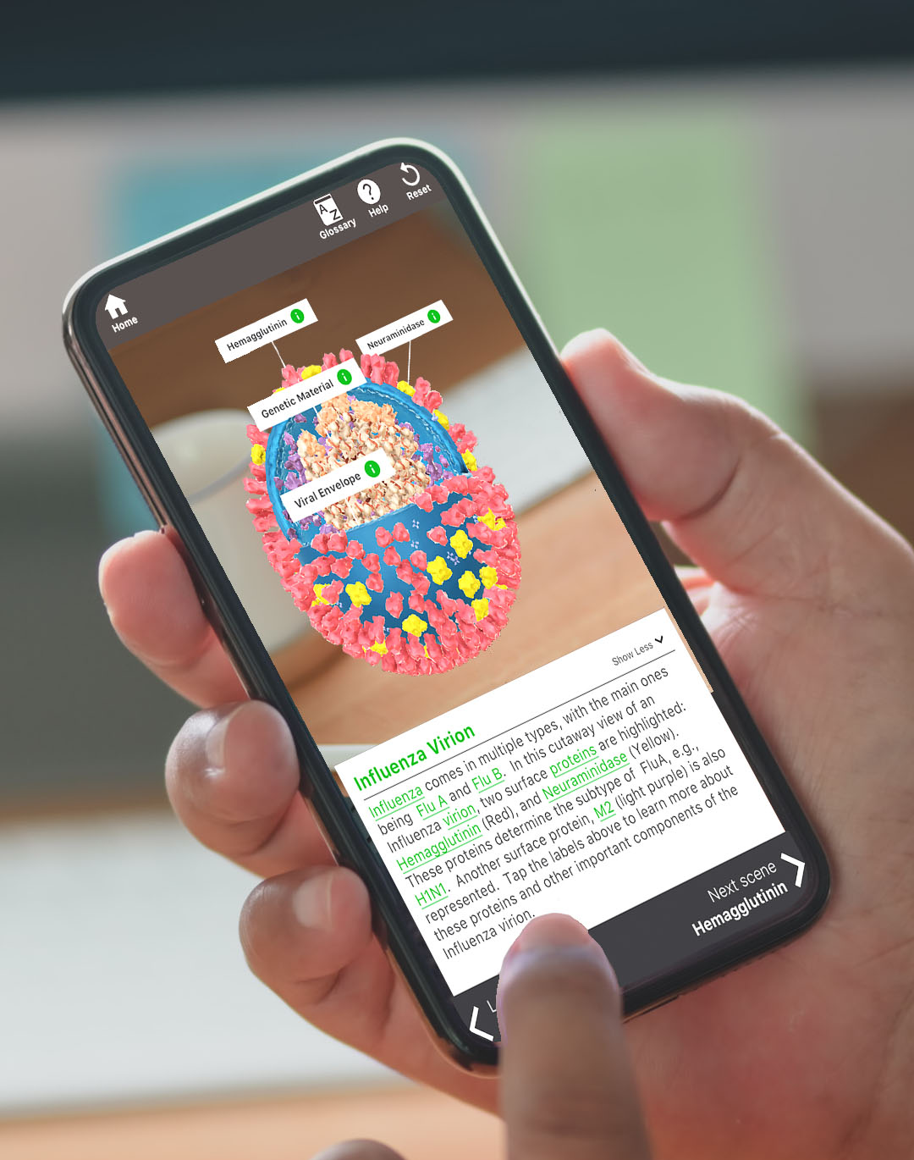
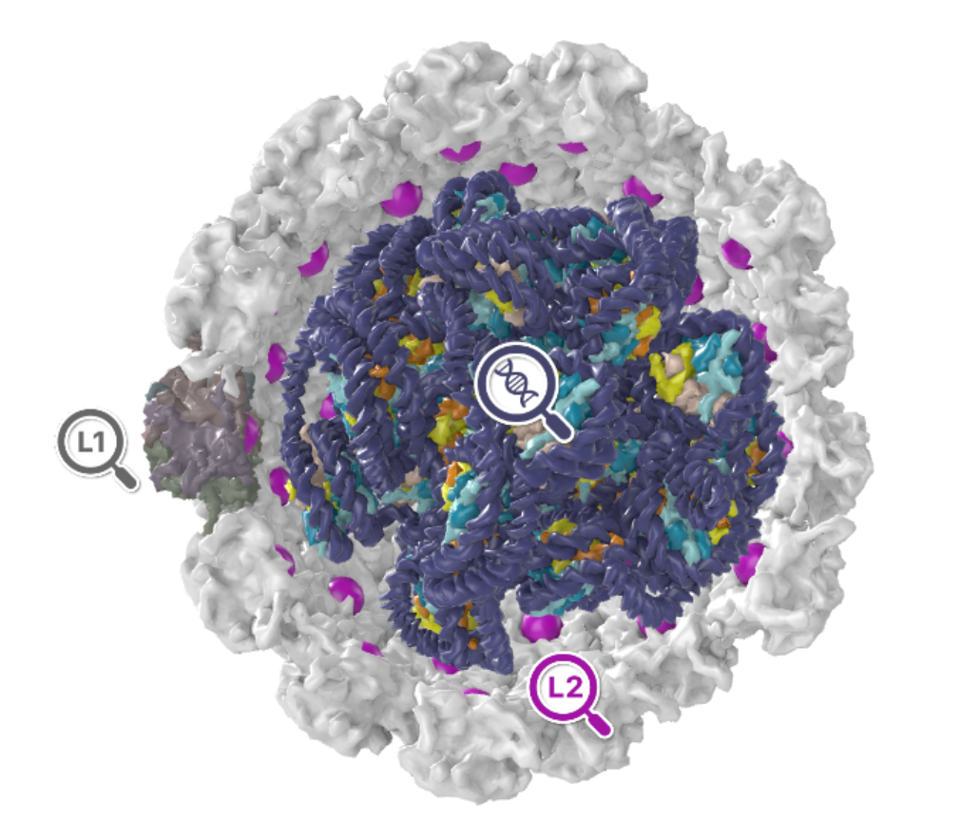

My Journey in Programming
Undergrad
Introduction to Java
NIH 3D Workflows
Python
Building NLM 3D
Javascript, d3.js, MEL
Mesh repair for 3D printing
File conversions
Decision tree for mesh processing
Rendering
Exporting Textures/Animations
Batch processing
Building Pathogen AR
C# for Unity
CHAT GPT
BioArt Metadata Handling
Python
Building TB in 3D, PaVE 3D, NIH 3D Viewer
Javascript (Babylon.js, Three.js)
Use metadata from hundreds of files to develop organizational structure and retroactively update file headers.
It’s never to late to learn.
Learning one language makes it much easier to learn the next.
Notes:
My journey in programming began with Java during undergrad, though it didn't quite click for me at the time. I struggled to grasp the underlying logic of programming by the end of the course. Fast-forward 15 years, I found myself as a research fellow at the National Library of Medicine, independently building a 3D anatomical model library. This endeavor required me to develop everything from the server and database to the front end. JavaScript became my primary tool, well-suited for web development with its diverse package ecosystem. I utilized d3.js for interactive data visualizations and maps, and even ventured into Mel, Maya's scripting language, to automate rendering outputs and turntables for the models.
my focus shifted when I joined the National Institute of Allergy and Infectious Disease. Here, I took on an Augmented Reality App project, where I delved into C#. As a language more Microsoft-centric, C# is commonly used for Windows app and game development, as well as .NET applications. I later returned to JavaScript, particularly leveraging Babylon.js and Three.js for building web-based 3D interactives.
My path then led me to Python when I began working on NIH 3D, a repository and library for 3D models. Initially, my focus was automating mesh repair processes for 3D printing, alongside developing new workflows for our upcoming Workflows 2.0 release. Python's versatility and logical similarities to JavaScript and C# made it an excellent fit. It was around this time that ChatGPT emerged as a game changer for me, but I'll touch on that shortly.
Since then, Python has been integral to managing metadata and file headers for our "BioArt" project, among other tasks.

Slide 4
Python
This is NOT a code talk
What will be discussed:
What is Python?
What are some simple scenarios where it’s helpful?
Building examples of building up a workflow in Python
Notes:
So lets start with what is Python. This is not a code talk. I will show you code, but I’m not going to walk you through it. I want you to have a sense of what Python is, where its helpful, and how you can use tools like AI to start to build your own programs. Learning python and how to set up your environment is another subject and there’s lots of resources available online.

Slide 5
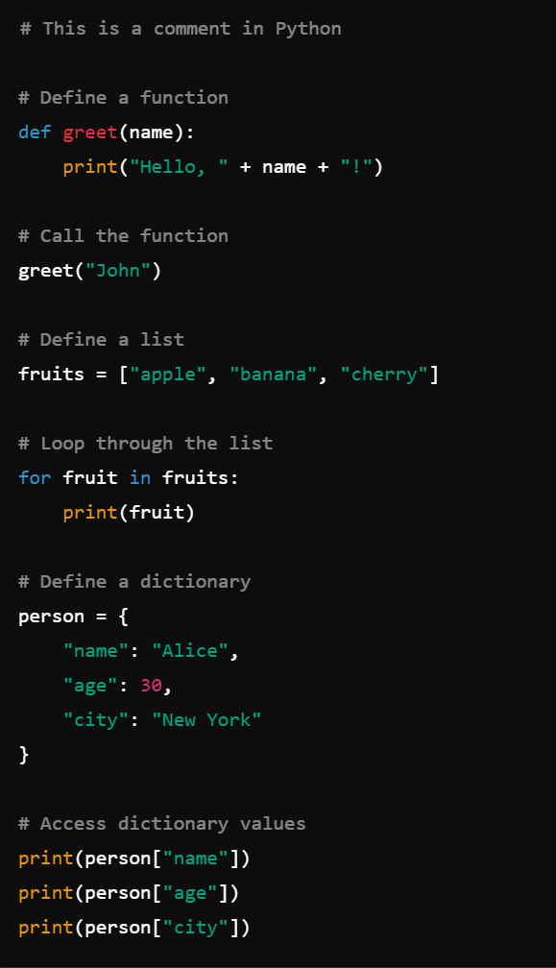
What is Python?
Programming Language: A structured set of instructions that a computer can understand and execute
High-Level Programming Language
Python is easy to read and write due to its high-level nature, which abstracts complex details from the programmer.
Interpreted Language
Python runs without needing compilation, allowing for faster development cycles. However, its interpreted nature can make execution slower compared to compiled languages.
General-Purpose
Python is widely used across various fields such as web development, research, data analysis, scientific computing, and 3D modeling/animation.
Cross-Platform
Python is compatible with multiple operating systems, including Windows, macOS, and various Linux distributions.
Extensive Libraries/Modules
Python has a rich ecosystem of libraries and modules, including Pillow and OpenCV for image processing, and MeshLab (pyMeshLab), Blender (bpy), and Trimesh for 3D model processing.
Notes:
So first up – What is python? It’’s a programming language which is essentially a structured set of instructions for a computer to understand and execute. Python is a high-level language, which makes it easier to read than lower level languages like assembly, machine code, C, and other more hardware-centric languages. You can see on the right a simple example of python code and it’s very readable with relatively simple logic. It’s an interpreted language which means that it doesn’t need to be compiled. Anyone who has worked in Unity has known the pain of waiting for a program to compile before it can be tested. This has benefits and drawbacks as it’s faster to develop, but can have slower execution times. It is a widely used language bridging many fields that touch on medical illustration. You’ll see python interfaces in software like Maya and Blender as they move towards using a common language. It is also cross-platform, so no worries about the great Mac/Windows debate. I use Windows, but all of the developers I work with use Mac (which is common in bioinformatics). It isn’t generally a problem for us to share code, but we do need to set up our environments a bit differently sometimes. Finally, python has extensive libraries that are applicable to our field including data viz, image, 3d graphics processing.

Slide 6

Why Blender (bpy)?
It’s FREE
It has robust modeling, animation, and rendering capabilities
Everything can be automated using the Blender Python API (bpy) without opening the Blender GUI
ADD CUBE
bpy.ops.mesh.primitive_cube_add()
API – Application Program Interface
Export
A set of functions and tools provided by blender to interact with the software programmatically.
When you click a GUI button, you trigger an API call to a specific function in bpy.
FBX
C:/Myfile.fbx
bpy.ops.export_scene.fbx(filepath=c:/Myfile.fbx)
import bpy
bpy.ops.mesh.primitive_cube_add()
bpy.ops.export_scene.fbx(filepath=c:/Myfile.fbx)
Notes:
I’m going to be talking about a lot of examples using Blender, which is a 3D modeling, animation, and rendering page. Why Blender? First of all, it’s completely free. This is critical for my work because I needed a package that can be built into the back end of my model processing workflows in NIH 3D. It’s also the software of choice for many researchers, and it has better support of formats like GLTF than a lot of commercial packages. While the UI can be frustrating, it has robust modeling, animation, and rendering capabilities, and it’s usability is getting better and better. It has an active development community and you can customize it in a lot of different ways. It’s also very performant, especially in more recent versions. Everything in Blender can be accessed through the Blender Python API (bpy), you don’t even actually need to open the Blender GUI, you can just use bpy as a python module which is amazing.
But before I go to far? What is an API? It’s a set of functions that allow you to interact with software programmatically. Essentially, when you click a button on a GUI, you’re triggering one or more commands from the API. For example, “Add Cube” in Blender launches this command. Then Export FBX, then you type the filename, would trigger this command. But you don’t need a GUI to do this, you can write a python script where you import bpy, issue those commands, and it will do the exact same thing.

Slide 7
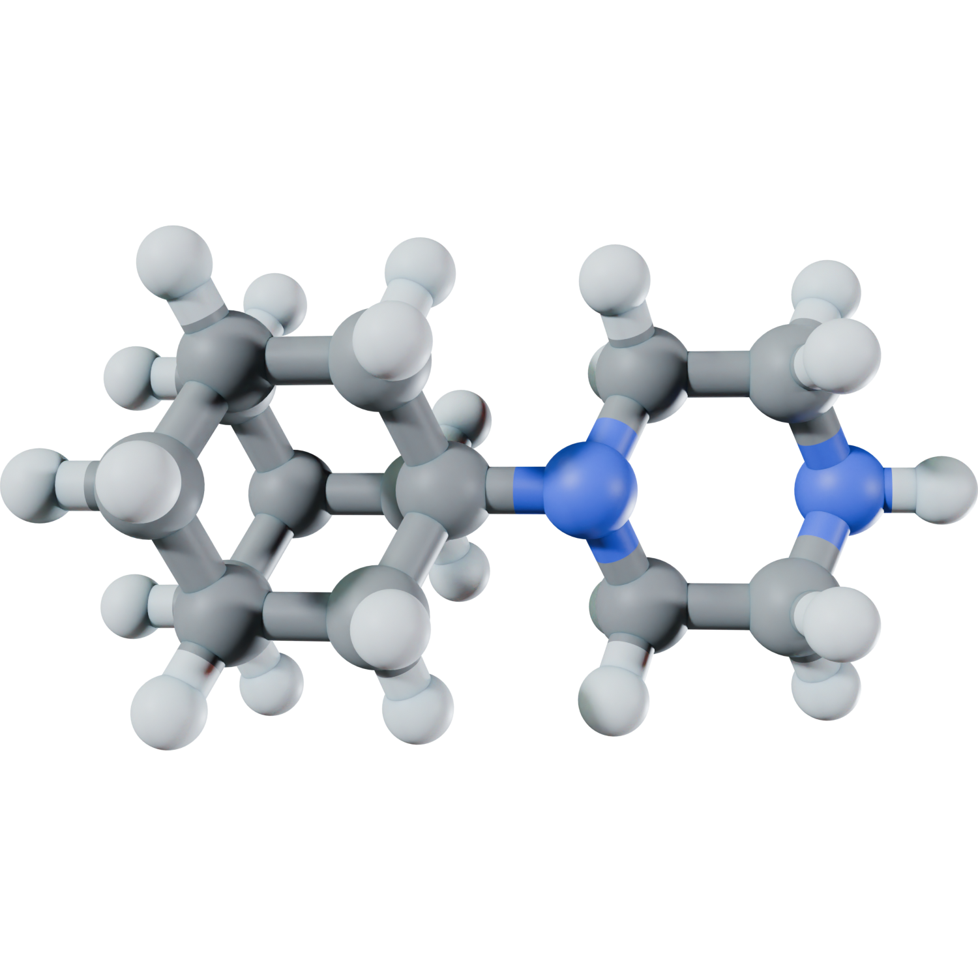
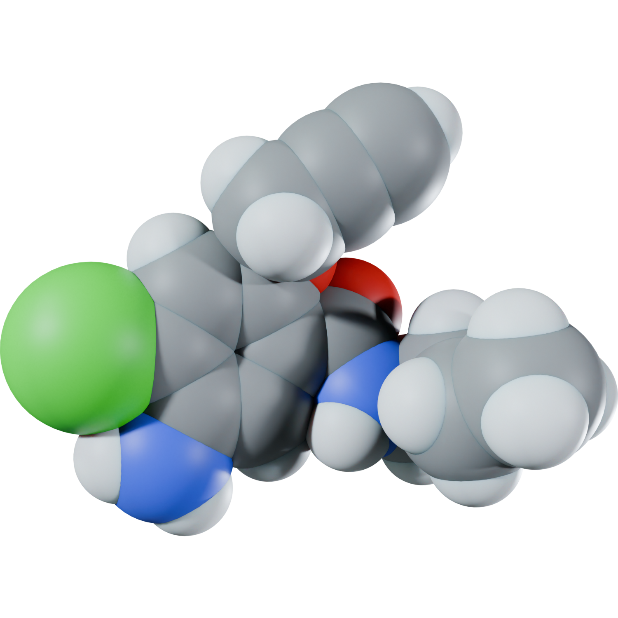
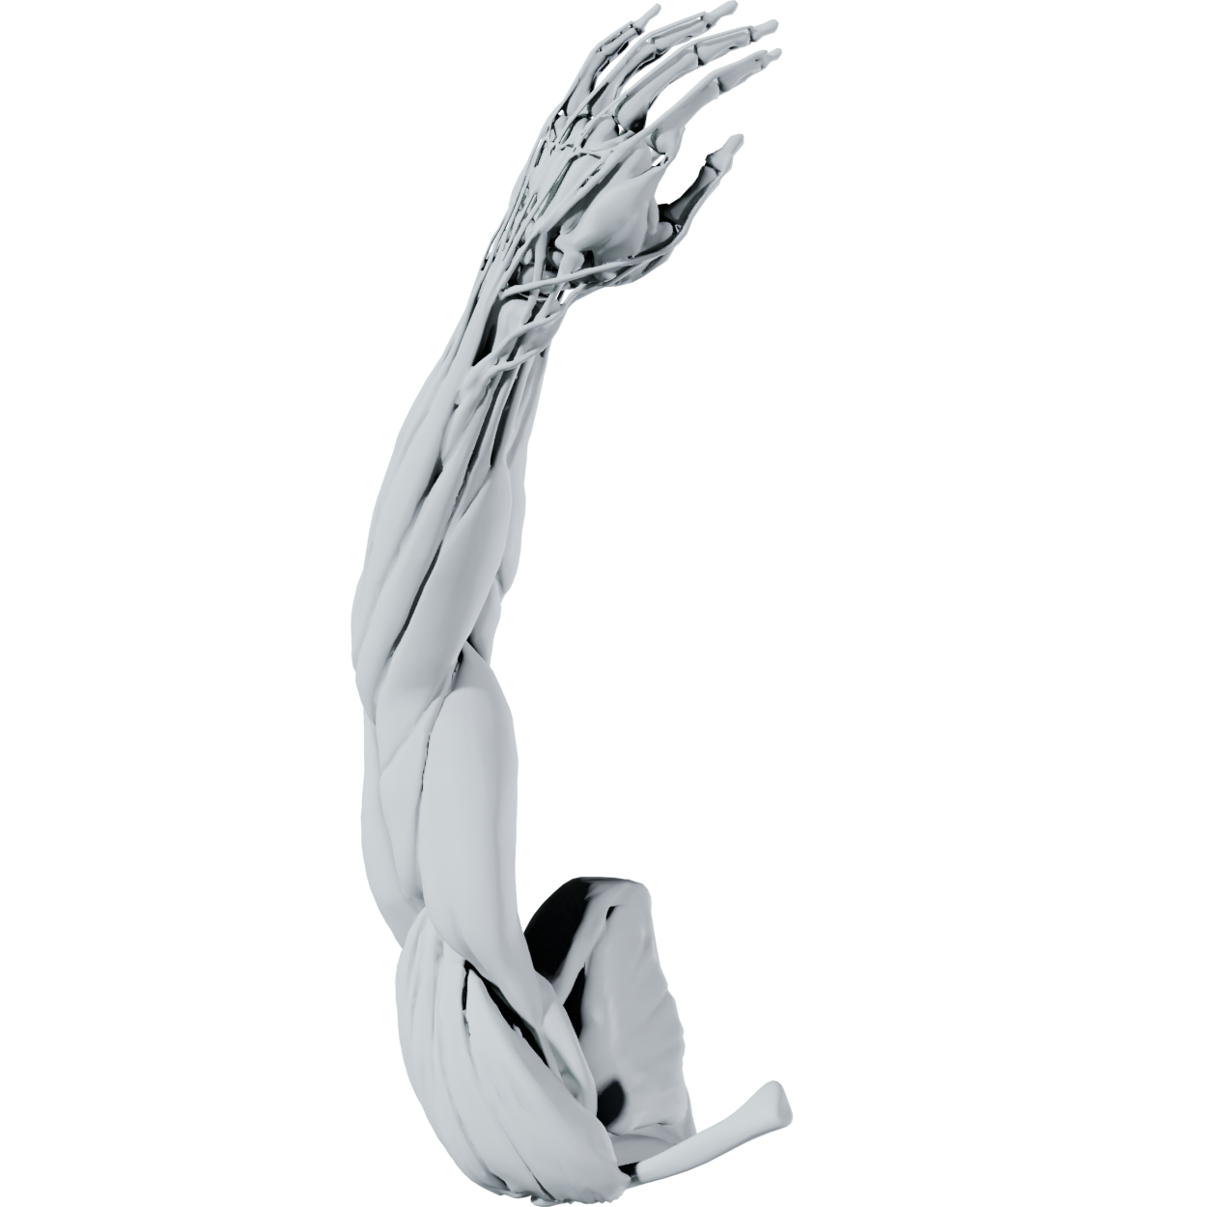
How can I use Python?
2D Image Manipulation (pillow)
Image resizing, cropping, enhancing, filters, and exports
3D Model Creation/Manipulation
Rendering/Animation/Simulation (bpy)
3D mesh optimization (bpy, pymeshlab, trimesh)
Medical Imaging (Slicer, VTK, ITK)
Molecular Modeling (ChimeraX, MMTK)
Data Visualization (matplotlib, plotly…)
Organizational tasks
Batch Processing
Workflow development
And more!
Notes:
You may be asking yourself, well how can I use python?
2D graphics people, anything that you might do with a photoshop action you can also do with python. Some adobe products have a python API. Doing it from python would allow you to add more logic and nuance though. For example, if you only want a set of actions to proceed IF the image you load has specific dimensions, then if they don’t match those dimensions, do something out. Branching logic is very straight-forward in Python.
3D modeling has tons of use cases. Rendering, animation, simulation, rigging, optimization. There’s python interfaces for the medical imaging package 3D slicer, ChimeraX for molecular modeling can also be accessed this way. Then there are numerous smaller packages for manipulating these as well like ITK and VTK for medical imaging and MMTK for molecular modeling.

Slide 8
Where does AI Fit in?
Positives
Code drafting
Debugging (Why do I have this error??)
Learning new APIs (Application Program Interface)
Idea generation
Documentation
Limitations
It’s an assist, not a replacement
It may have out of date information
Data Privacy / Security
Your queries and its outputs are limited in size.
It is limited to what it has learned from
Notes:
A big question these days is how does AI fit in. I’m not talking bout graphics generators like Midjourney as that’s a different conversation. This is about Code generation tools like GitHub Copilot, although you can just directly ask ChatGPT as well. AI is an absolute gamechanger in the coding world. It is excellent at drafting code, debugging, and commenting tool. It can help you learn syntax, especially new APIs (basically the programming commands used by specific programs like blender), and it can also help comment your code which is an essential part of the documentation process. But it’s not perfect. It’s an assist, but not a replacement. I say yet because you need to consider that it is very very good and it is currently the worst it will ever be. But for now, it isn’t always up to date and can reference outdated commands. It’s limited to what it is trained on, so if you’re doing something novel, you need to lead it through what you want it to do. There are privacy and security concerns detpending on how you want to use your code, and it also takes limited inputs and output sizes so you can’t just drop in an enormous program and expect it to work. It’s about snippets.

Slide 9
Examples Check
github.com/niaid/AMI_2024_Examples
Notes:
From here, I’m going to walk you through an example of how you can slowly build up a useful program. All of the code is in GitHub at this URL. GitHub is a code repository and a tremendous resource for anyone developing code. It keeps a history of all changes you make in your programs and also allows for collaborative work. And it’s free (mostly).

Slide 10
Most Important thing is…
LOGICALLY BREAK DOWN TASKS
Almost like button clicks…
NOTE:
These examples use CHAT GPT heavily in the code-drafting process
It’s great for beginners to learn syntax
It’s faster than typing, especially for routine tasks
Notes:
The most important thing for developing a program is to break it down into logical tasks like button clicks. I click this, then this, then this. There are ways to be more efficient in code, but this is for Beginners, so I want to make this as simple as possible. If your code works, it doesn’t always have to be the most efficient to get the job done. Especially for personal/internal use.

Slide 11
Convert a Directory of 3D Files
Problem: I have a directory of GLB files that I need in FBX and DAE format.
What does the code need to do?
The same thing a GUI would need to do
Import the file from a provided location
Export the file (Where? What should the file be called?)
Remove everything from the scene
Import the next file…
Blender-Specific Issue -
Make sure that Blender doesn’t lose context
(it needs to be in the correct “mode”)
GLB
GLB
GLB
GLB
FBX
DAE
Notes:
The first program I’m going to write here, is a program to convert a directory of GLB files into FBX and DAE format. So how do I start? I need to think about what the program needs to do, this time in the context of Blender as I’m going to use the Blender API (you could use others). If I were in Blender, I would import a file from a specified place, I would export the file to a specific place and say how to name it, then I’d remove everything from the scene and import the next file. There is a Blender-specific issue where you need to be in different “modes” when doing certain tasks and this is called “context”. It is helpful to remember this. You may be wondering, how do I know what commands to use? In Blender, you can turn on Python tooltips, then when you hover over any item in the menus, it will show you the command! You can also look into their API documentation, or better yet, start with some AI!

Slide 12
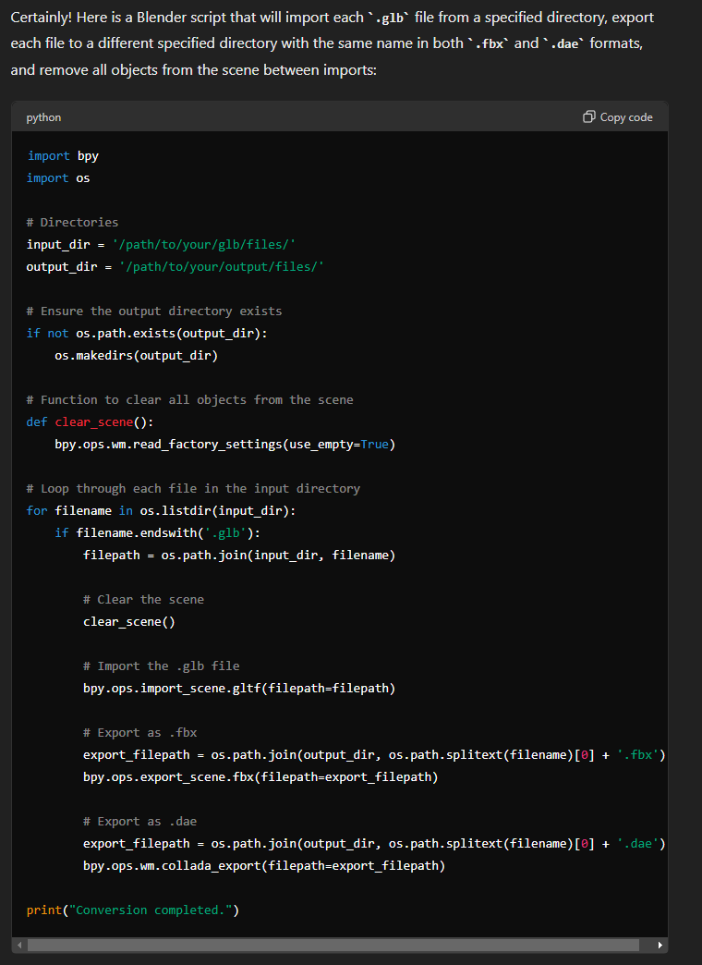
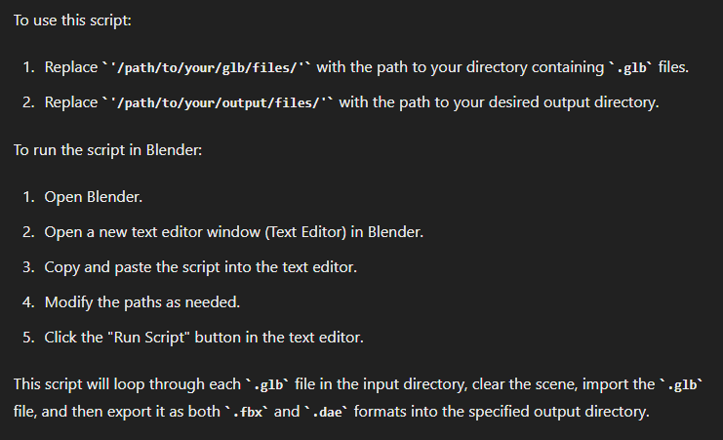
Ask Chat GPT
https://chatgpt.com/
“Could you write a Blender script that would import each glb file from a provided directory, then export that file to a different specified directory with the same name in fbx and dae formats. Make sure to remove all of the objects from the scene between imports and that the objects are in the correct context.”
This works immediately without any changes.
I tried a small batch of 12 files, it took <10sec to spit out 24 files.
Input Dir
GLB
Bob.glb
Output Dir
GLB
GLB
Bob.fbx
Bob.dae
Notes:
When talking to a code generator, it’s key to be explicit and not ask too much. In the above prompt I ask it very specifically to so all of the things I summarized in the previous slide, and this is what it spat out. I dropped this in the scripting window in Blender, provided the input and output directories, then hit “play”. It worked immediately. I didn’t even have to change it. It output 24 files in less than 10 secs. It doesn’t always work right away. Before I asked it to specify context, I had a context error so I dropped that into the ChatGPT window and it told me what was wrong. Sometimes this takes a few tries, sometimes it doesn’t work, but it always helps! What might we want to do next? You could add more formats, make sure it clears everything from the scene (not just mesh files)… lots of things1

Slide 13
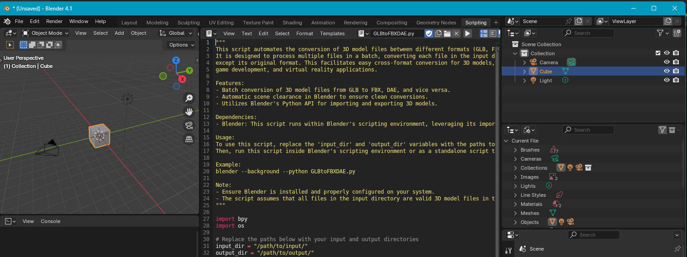
How do I Run a Python Script?
Install Python (https://www.python.org/downloads/) or a package manager (Conda, Miniforge, Anaconda)
Save program as “.py” file
Run the “.py” file:
Inside a program (e.g. Blender or your IDE)
From the command line:
Go to the directory the script is in:

Slide 14
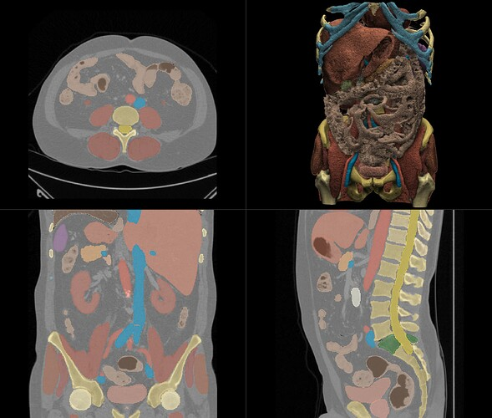
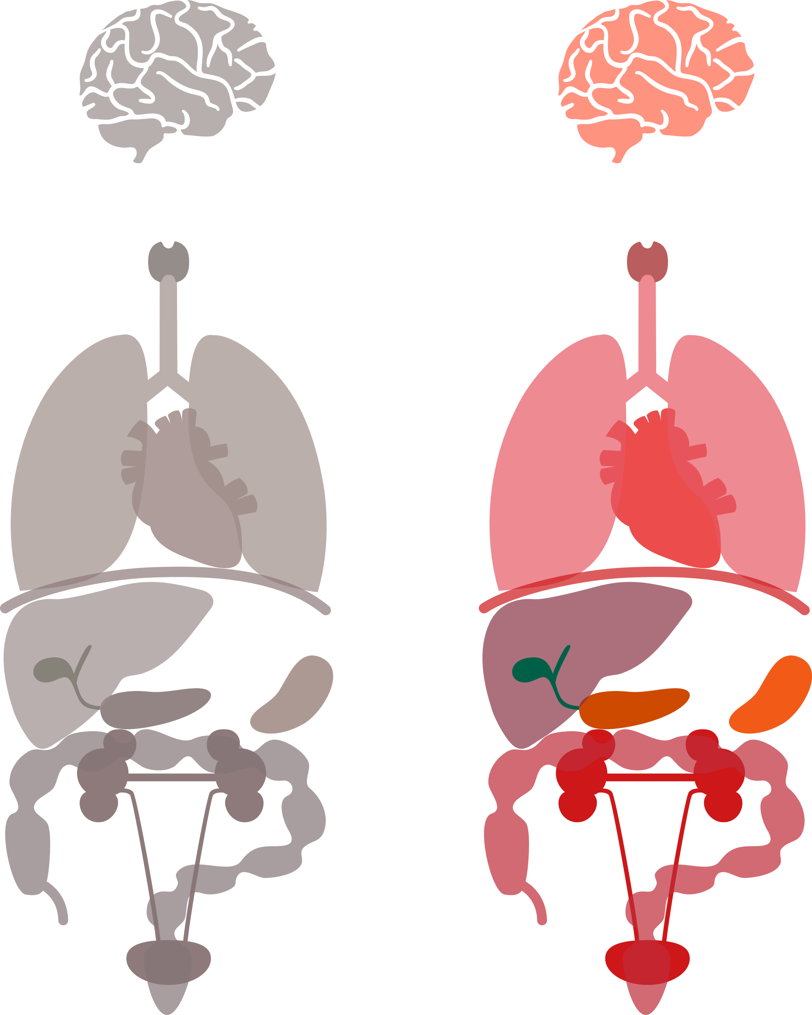
Apply Materials to a Set of Models
AI Segmentation with Total Segmentator
Problem: I have processed a set of DICOMs into sets of STL files. I’d like each set of STL files to be a single GLB file. I’d also like each STL to have a material applied that is appropriate for the organ it represents.
3D Slicer Integration:
discourse.slicer.org/t/totalsegmentator-v2/32470
Prep your Files:
Put each “set” of STL files into its own subdirectory
Name your STL files consistently (liver, lung…)
What does the code need to do?
Define the input and output directories and what to name the outputs
Define the materials you want to use
Got through each set and do the following:
Import all STLs in the same set into the scene
Assign materials to the meshes based on the node name
Export as GLB
Remove the mesh objects (don’t delete the materials ☺) and do everything again on next set
liver.stl
liver.stl
heart.stl
heart.stl
lung.stl
lung.stl
…
colon.stl
colon.stl
dicom1
dicom2
Drag and Drop Interface
totalsegmentator.com/
GitHub Repo
GLB
github.com/wasserth/TotalSegmentator
Notes:
Lets try a more complicated example. I have a set of DICOMS that have been segmented using this AI tool, Total segmentator. I want to take all of the STLs that were generated, import them into Blender, assign materials based on the names of the files, smooth shade them, then export them together as on GLB. To do this requires some prep. If I have many sets of STLs, I have to decide a consistent organization so that the program knows how to delimit them. I used folders, but you could use prefixes and other ways. You need to label your files consistently so it knows how to apply the materials (TS does this already), then if you want specific materials, you want to define these up front noting their specular, metallic, color etc. so you could feed it in.

Slide 15
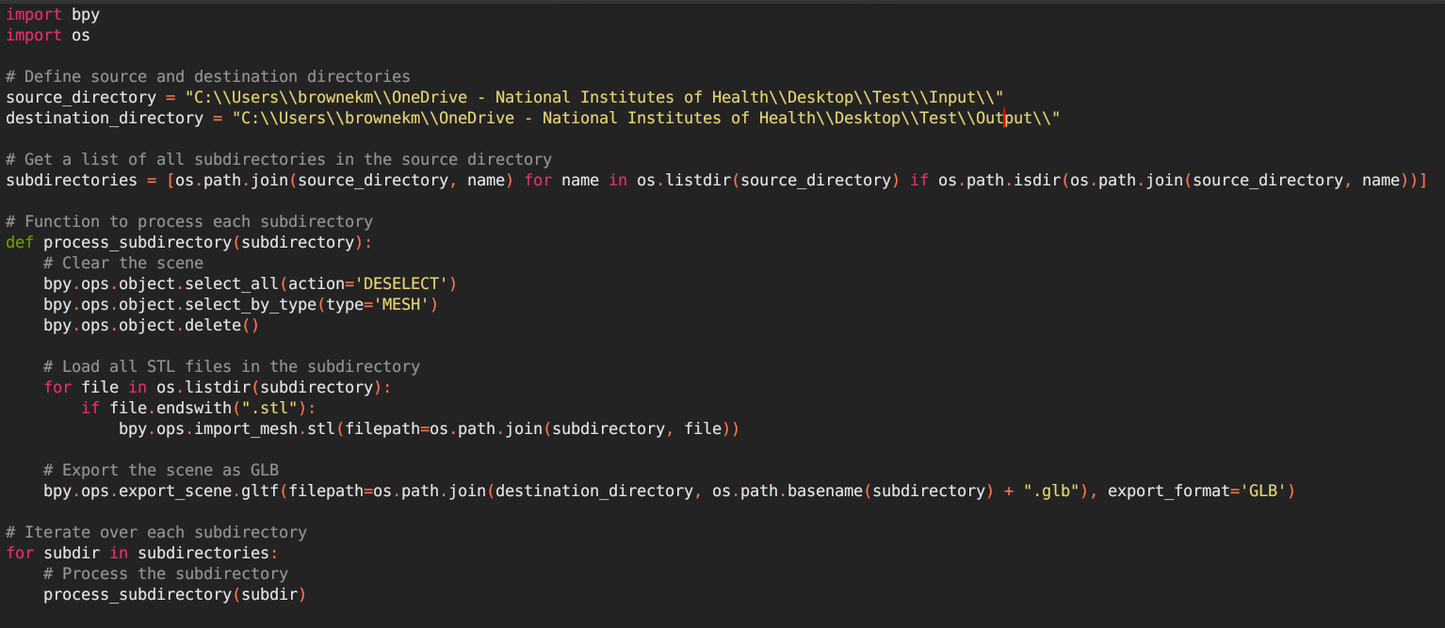

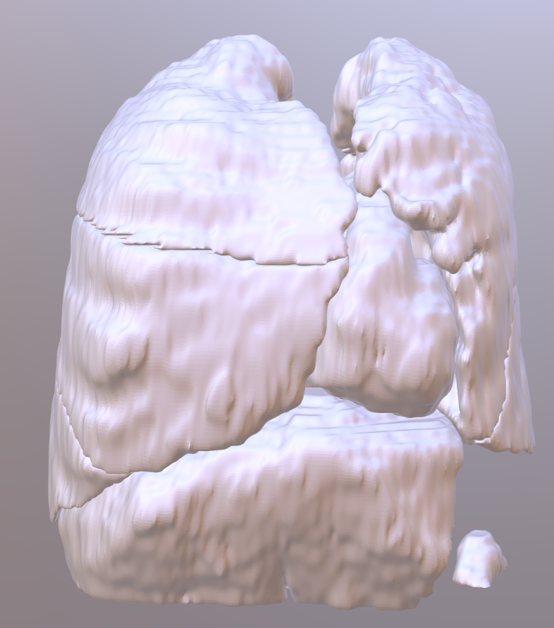
Ask Chat GPT
STEP 1
“Write a Blender script to systematically process a designated directory containing multiple subdirectories.
The script should traverse each subdirectory and perform the following tasks:
1. Load all STL files found within the subdirectory.
2. Export the scene as a GLB file named after the subdirectory.
3. Place the exported GLB files into a specified folder.
4. Clear the Blender scene of all mesh objects before moving to the next subdirectory.
It's crucial to ensure the script maintains the correct context throughout the execution.”
dicomSTLtoGLB_stage1.py
my_dicoms
dicom_1
my_glbs
liver.stl
heart.stl
colon.stl
inferior lobe of left lung.stl
inferior lobe of right lung.stl
…
dicom_1.glb
dicom_2.glb
dicom_2
liver.stl
heart.stl
colon.stl
inferior lobe of left lung.stl
inferior lobe of right lung.stl
…
Notes:
For this you can ask ChatGPT slowly. Lets start with some basic instructions to load all of the stls found in a subdirectory and export them as a GLB. Do it for all of the subdirectories in the provided directory. Here’s what we end up with! It works right away.

Slide 16
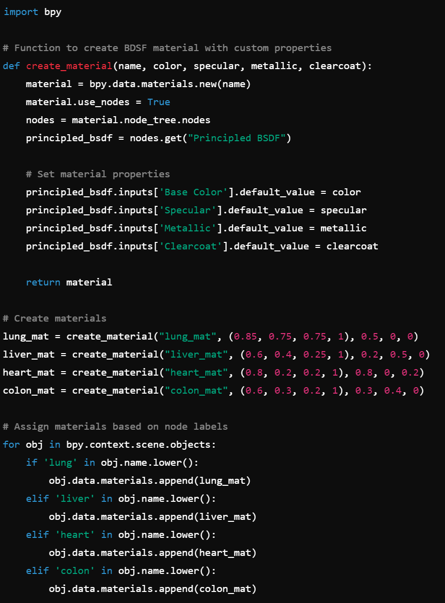
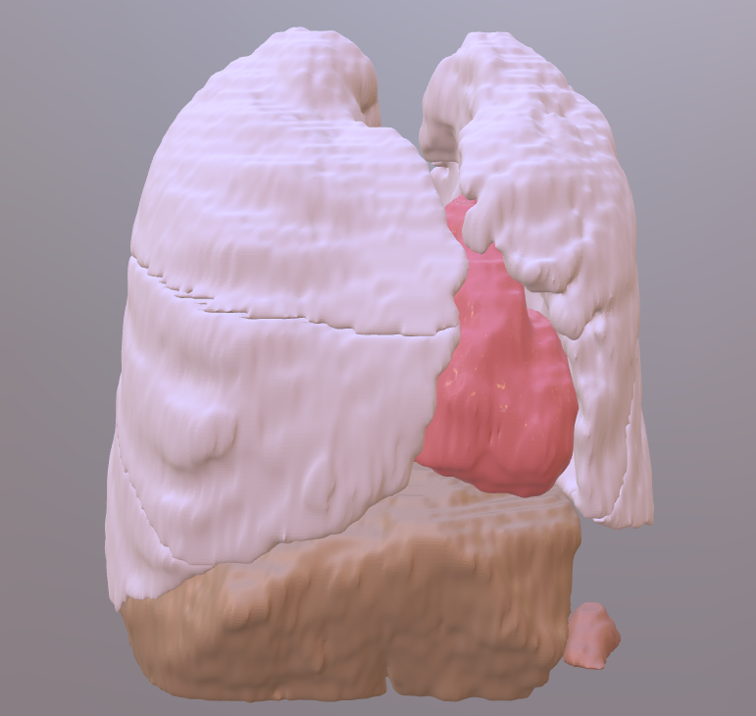
Ask Chat GPT
dicomSTLtoGLB_stage3.py
STEP 2
“Develop a Blender script to create four distinct BDSF (Bidirectional Scattering Distribution Function) materials named 'lung_mat', 'liver_mat', 'heart_mat', and 'colon_mat’.
Customize the properties of each material, including color, specular, metallic, and clear coat, to accurately represent lung tissue, liver tissue, heart tissue, and colon tissue respectively.
Subsequently, automate the application of these materials to corresponding nodes in the scene. Specifically, assign 'lung_mat' to any node containing the string 'lung', 'liver_mat' to any node labeled 'liver', 'heart_mat' to any node labeled 'heart', and 'colon_mat' to any node labeled 'colon’.”
Processing two sets of files took 38.35 sec
“Integrate this with the previous script”
What Next?
Why not do the TotalSegmentator segmentation from the script too!?
Notes:
Then I ask it to develop a script that creates four materials with specific names. In this case, I was a bit lazy and asked it to assign colors and textures that are appropriate for the named tissues. This was a gamble, but easy to edit if they get it wrong. I tell it to assign these materials based on the names of the loaded objects. It spat out the above script. These lists of numbers are the color, specular, metallic, and clearcoat values that you can then edit if the colors aren’t quite right. I then asked ChatGPT to integrate this with the previous script. I can do this myself, but it’s fast with ChatGPT!!. This is the result. It took less than 40 seconds to do this small subset of segmentations. The colors aren’t perfect, but not terrible either.
What might be do next? How about go straight from the DICOM to this GLB model?

Slide 17
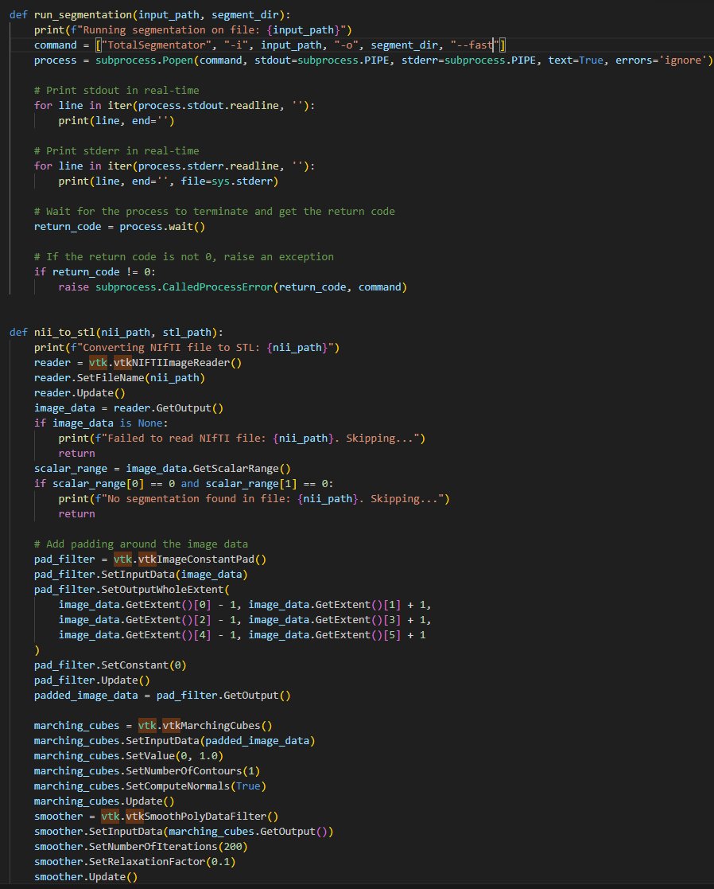
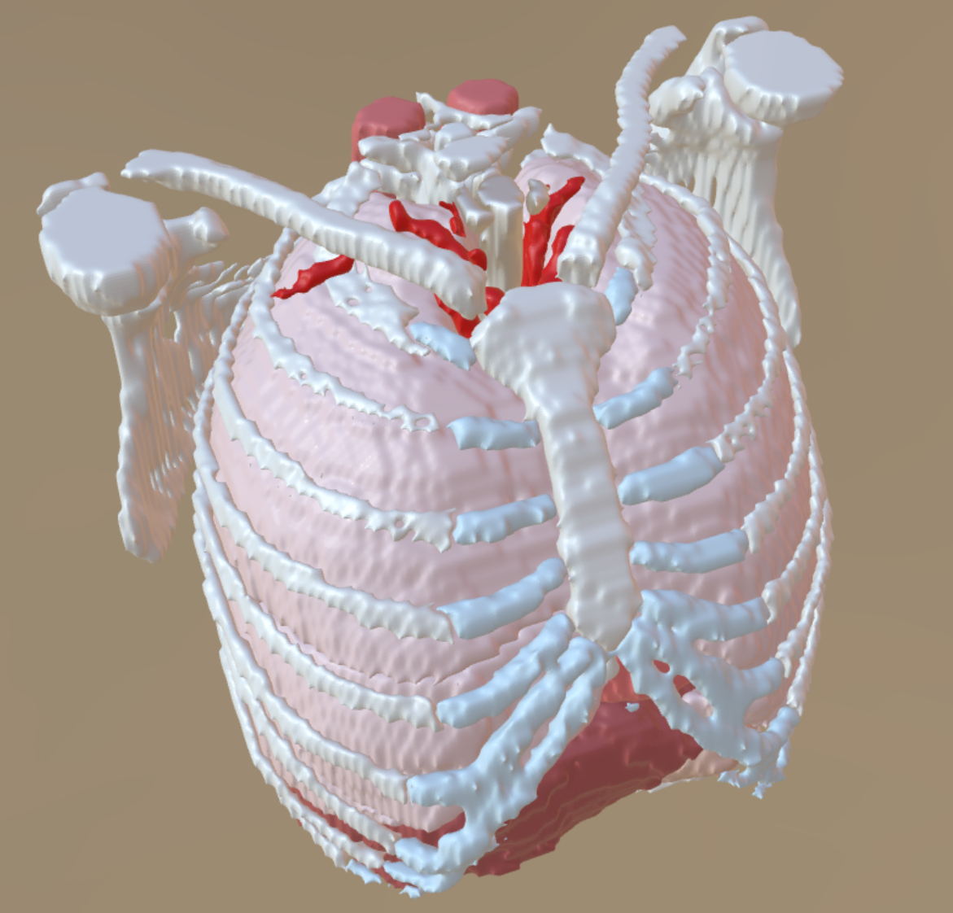
Ask Chat GPT (and DEBUG IT)
Can ChatGPT do everything right away? NO!
It took back and forth, looking at the problems, and progressive fixes, but in a fraction of the time I got here:
This was more complicated to work through:
Run Total Segmentator to get segmentations (nii.gz)
Create STLs from the segmentations (VTK)
Run the previous script to create the materials and output the GLB file
What Next?
You could output more formats, do mesh optimization, render stills or a turntable, send it to a web app…
170.5 sec from DICOM to GLB file
dicom2glb.py
Notes:
This is more complicated and required some troubleshooting, but the general idea was to use the TotalSegmentator to process a set of nii.gz files. It outputs a set of nii.gz files, one for each organ. I needed to use VTK (a package I’d never used before) to build the models and refine the parameters. I then needed to feed those stls into my previous script, add more materials, rotate the model, center it, then export as a GLB. Did this work immediately – NO! It’s a complicated program that needed refinement. I had to look at the product, look at the errors, then use AI, forums, and my own knowledge of these subjects to get to an endpoint. At one point I was a bit stuck. All of the models were open at the tops because that’s where the images ended. AI didn’t know what to do. So I asked a colleague who knew VTK better what I could do and he gave a me a general thing I could do that I then used AI to help me implement. In the end, it took 170.5 sec to go from the dicom to this GLB file that has around 80 anatomical parts. From here, this is a fine product for a lot of my applications, but you could easily refine this in Zbrush etc., to have a more polished result. You also have all the files from each step if you want to refine at any stage, and you can break apart the script to run just parts of it. This is referred to being “modular” and is one of the strengths of Python. You should always write your code in a “modular” way.

Slide 18
Take home message
You can automate many things to add efficiencies to your day-to-day work
AI is a TREMENDOUS assistant.
Start with small projects, and build from there
Notes:
You might be feeling overwhelmed at this point, so take a step back to our first example which was relatively simple. Each larger program is made up of several more simple tasks. I want the take how to be that this is useful, you can automate many things, and AI is a great tool to start. Start small, and you’ll slowly start developing more complex programs.

Slide 19
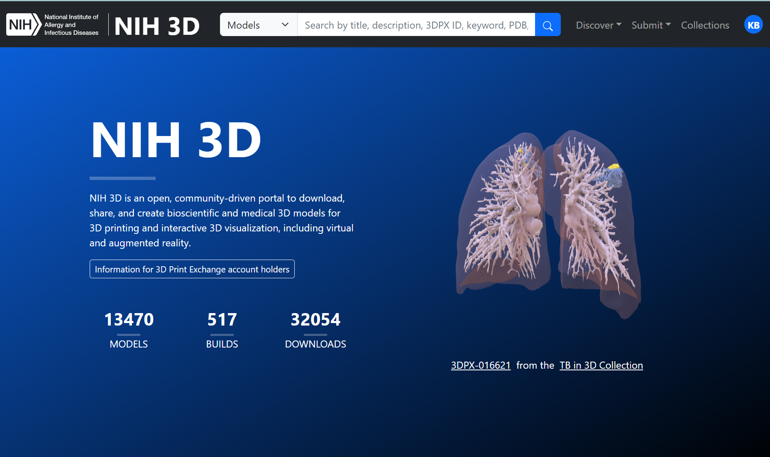
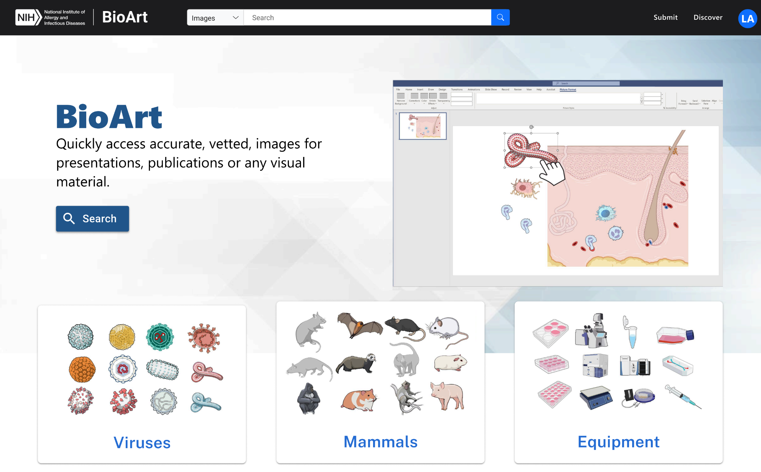
Free NIAID Resources
NIH 3D - 3d.nih.gov
3D Model Repository and 3D Model Creation Tools
BioArt (In Development) – FINAL NAME TBD
Anita Mora, Ryan Kissinger, Austin Athman – Visual and Medical Arts (NIAID)
Free Accurate and Vetted Science Graphics
Features
Deposit a 3D model and we convert it into several formats and render an image
Deposit molecular data and we process it into several representations in several formats and render an image
Perform automated mesh repair (experimental)
DOI Assignment
Features
Users can search for and download from over a thousand graphics generated by the NIAID Medical Arts team
On request we may add graphics from other groups if they meet the standards of the archive.
Notes:
Before I end, I need to give a shameless plug for our products that I’ve developed code for. NIH 3D is our model repository and creation site. We’re working on getting the new workflows I wrote up and running in prod and these will add a bunch of new formats and features. A new project that is coming out, likely in the late fall or early winter, is BioArt which is a graphics library from our team in Montana. It will have thousands of copyright free images for use in your projects.

Slide 20
Thank You
github.com/niaid/AMI_2024_Examples
kristen.browne@nih.gov
python.org/about/gettingstarted/
My Environment: Anaconda (Package Manager), Windows 11, Python 3.11.9, Visual Studio Code or PyCharm (IDE)
Notes:
With that, thanks you for having me. Here are some useful links. Please reach out with questions. I sometimes peek in on the AMI forum as well if you want to have a more public conversation.

